Slide 1
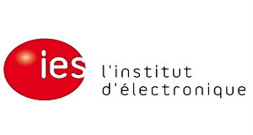
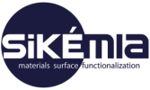
Characterization of self-assembled phosphonate monolayers on GaSb and InAsSb:Si surfaces
Cadiz Workshop
2016-05-18
Mario Bomers

Slide 2
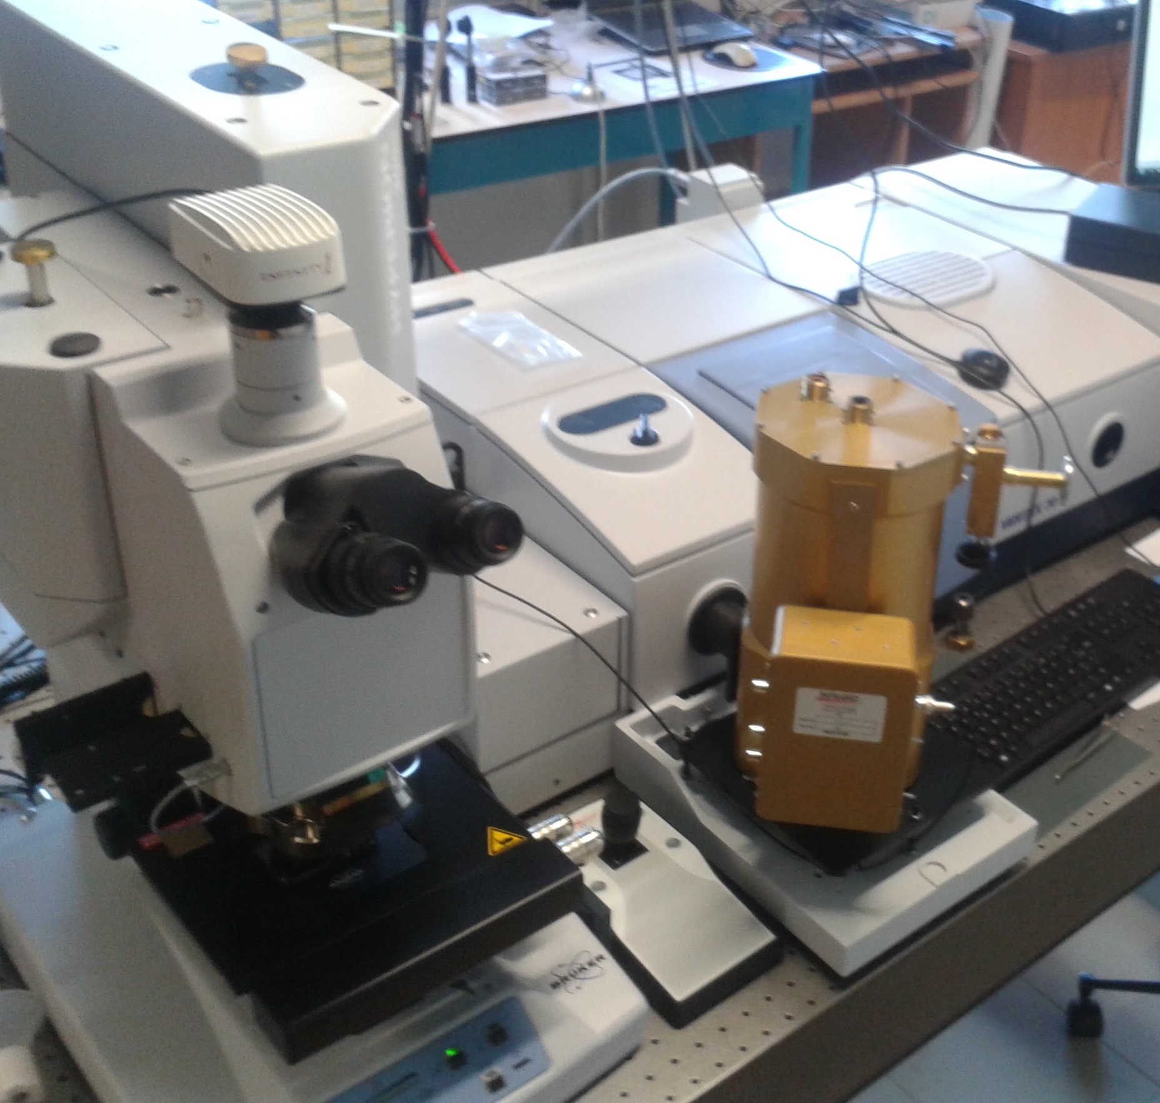
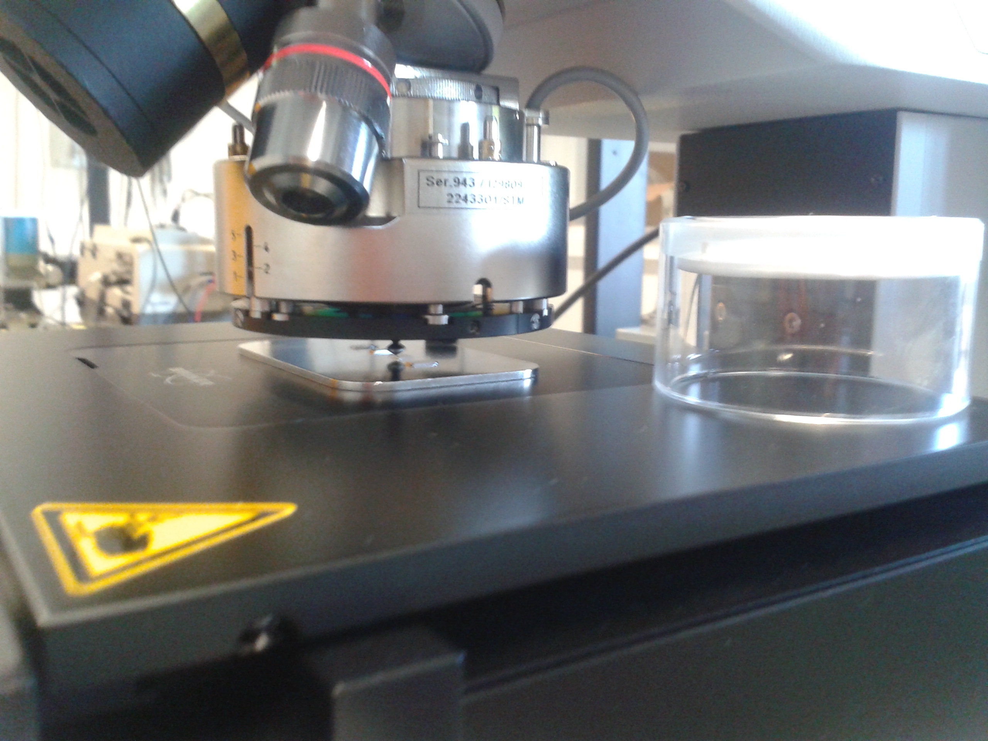
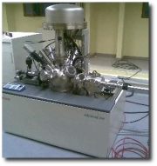
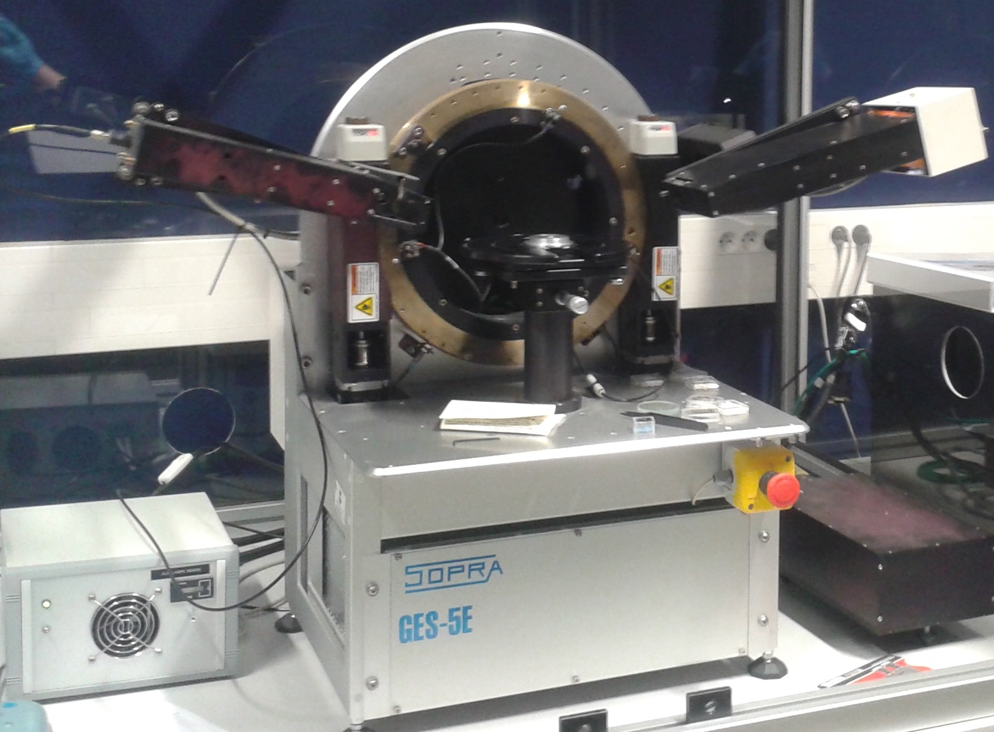
Project overview
hν
hν
hν
Surface Enhacement Infra-Red Absorption SEIRA-Spectroscopy on biomolecules
Bio-conjugation on surface
Design and technology
(plasmonic InAsSb/GaSb structure)
Some characterization techniques in Montpellier
XPS
ESCALAB 250
Al Kα [1486.6 eV]
Diameter: 400 µm
Ellipsometer
SOPRA GES-5E
[200-1000 nm]
FTIR (Vertex 70)
+ Microscope (Hyperion3000)
(+ ATR-Ge-crystal)
MCT-detector [ ̴ 1-23 µm]

Slide 3
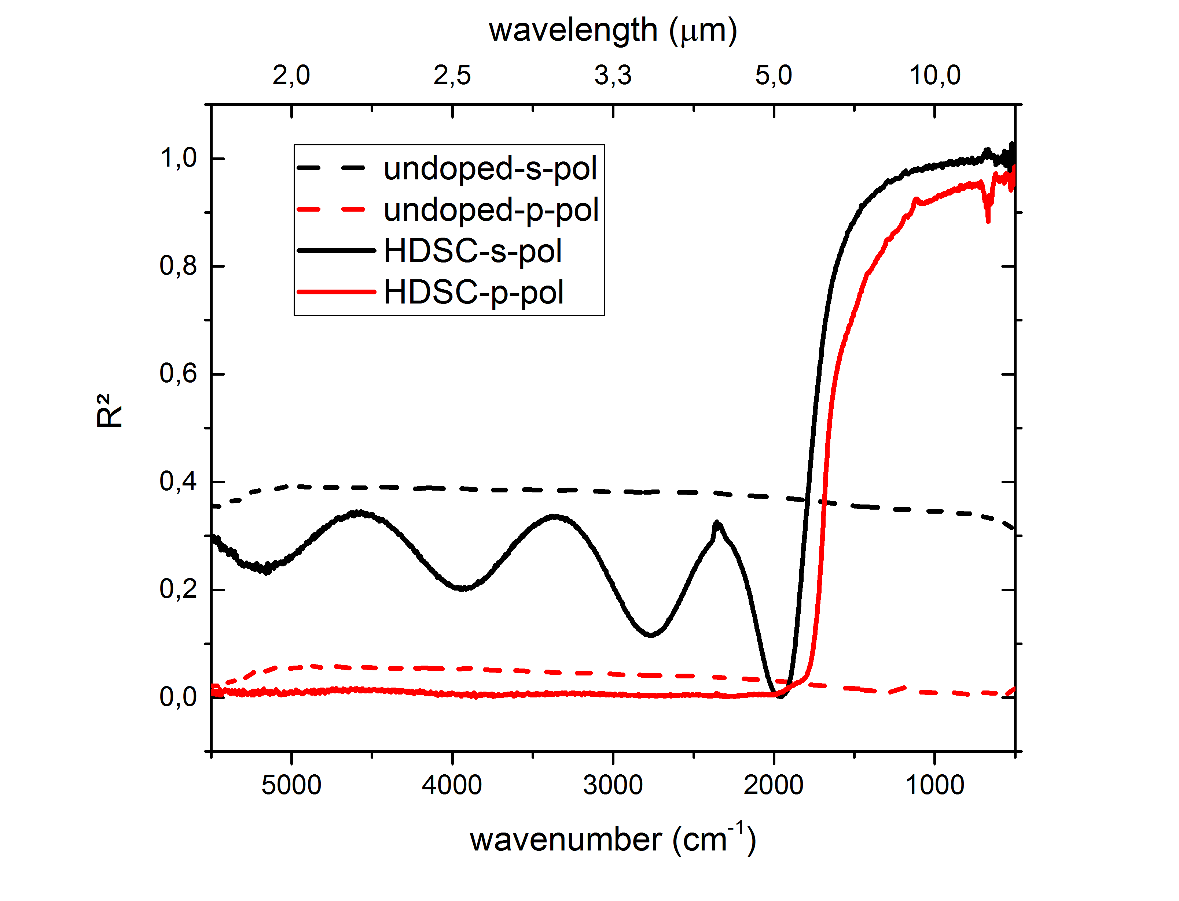
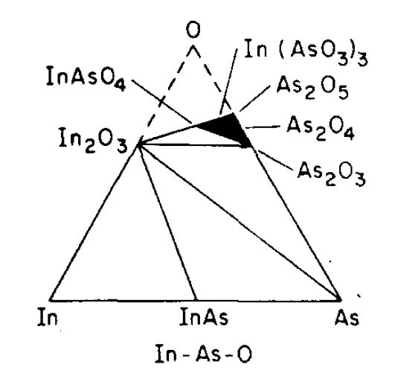
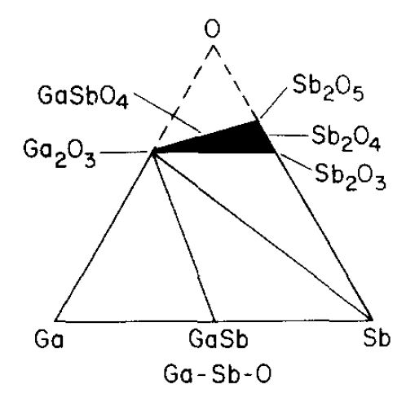
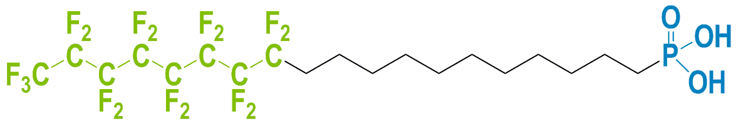
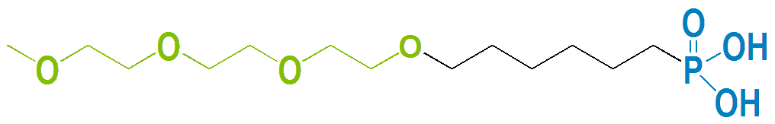
Effect of doping
=> mid-IR reflectivity
Exploiting the native oxide
=> Phosphonate coupling
Molecule Attachement
“FDPA”
Ultrasonic solvent cleaning (ethanol, chloroform)
Plasma activation
Immersion ( “FDPA” or “TEPA”)
Baking (> 12h)
Ultrasonic solvent cleaning (ethanol, chloroform)
“TEPA”

Slide 4
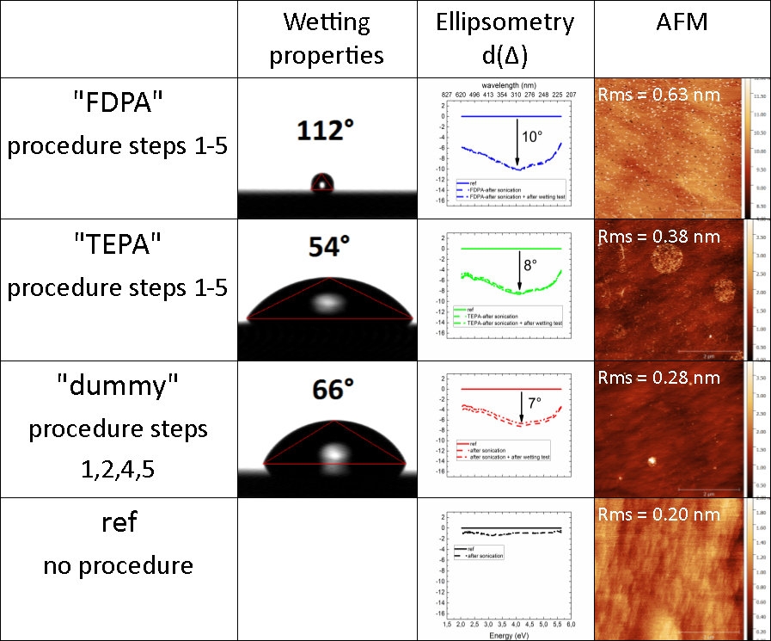
GaSb-surface
Plasma treatment
+ ultrasonic solvent cleaning
Untreated reference sample
4

Slide 5
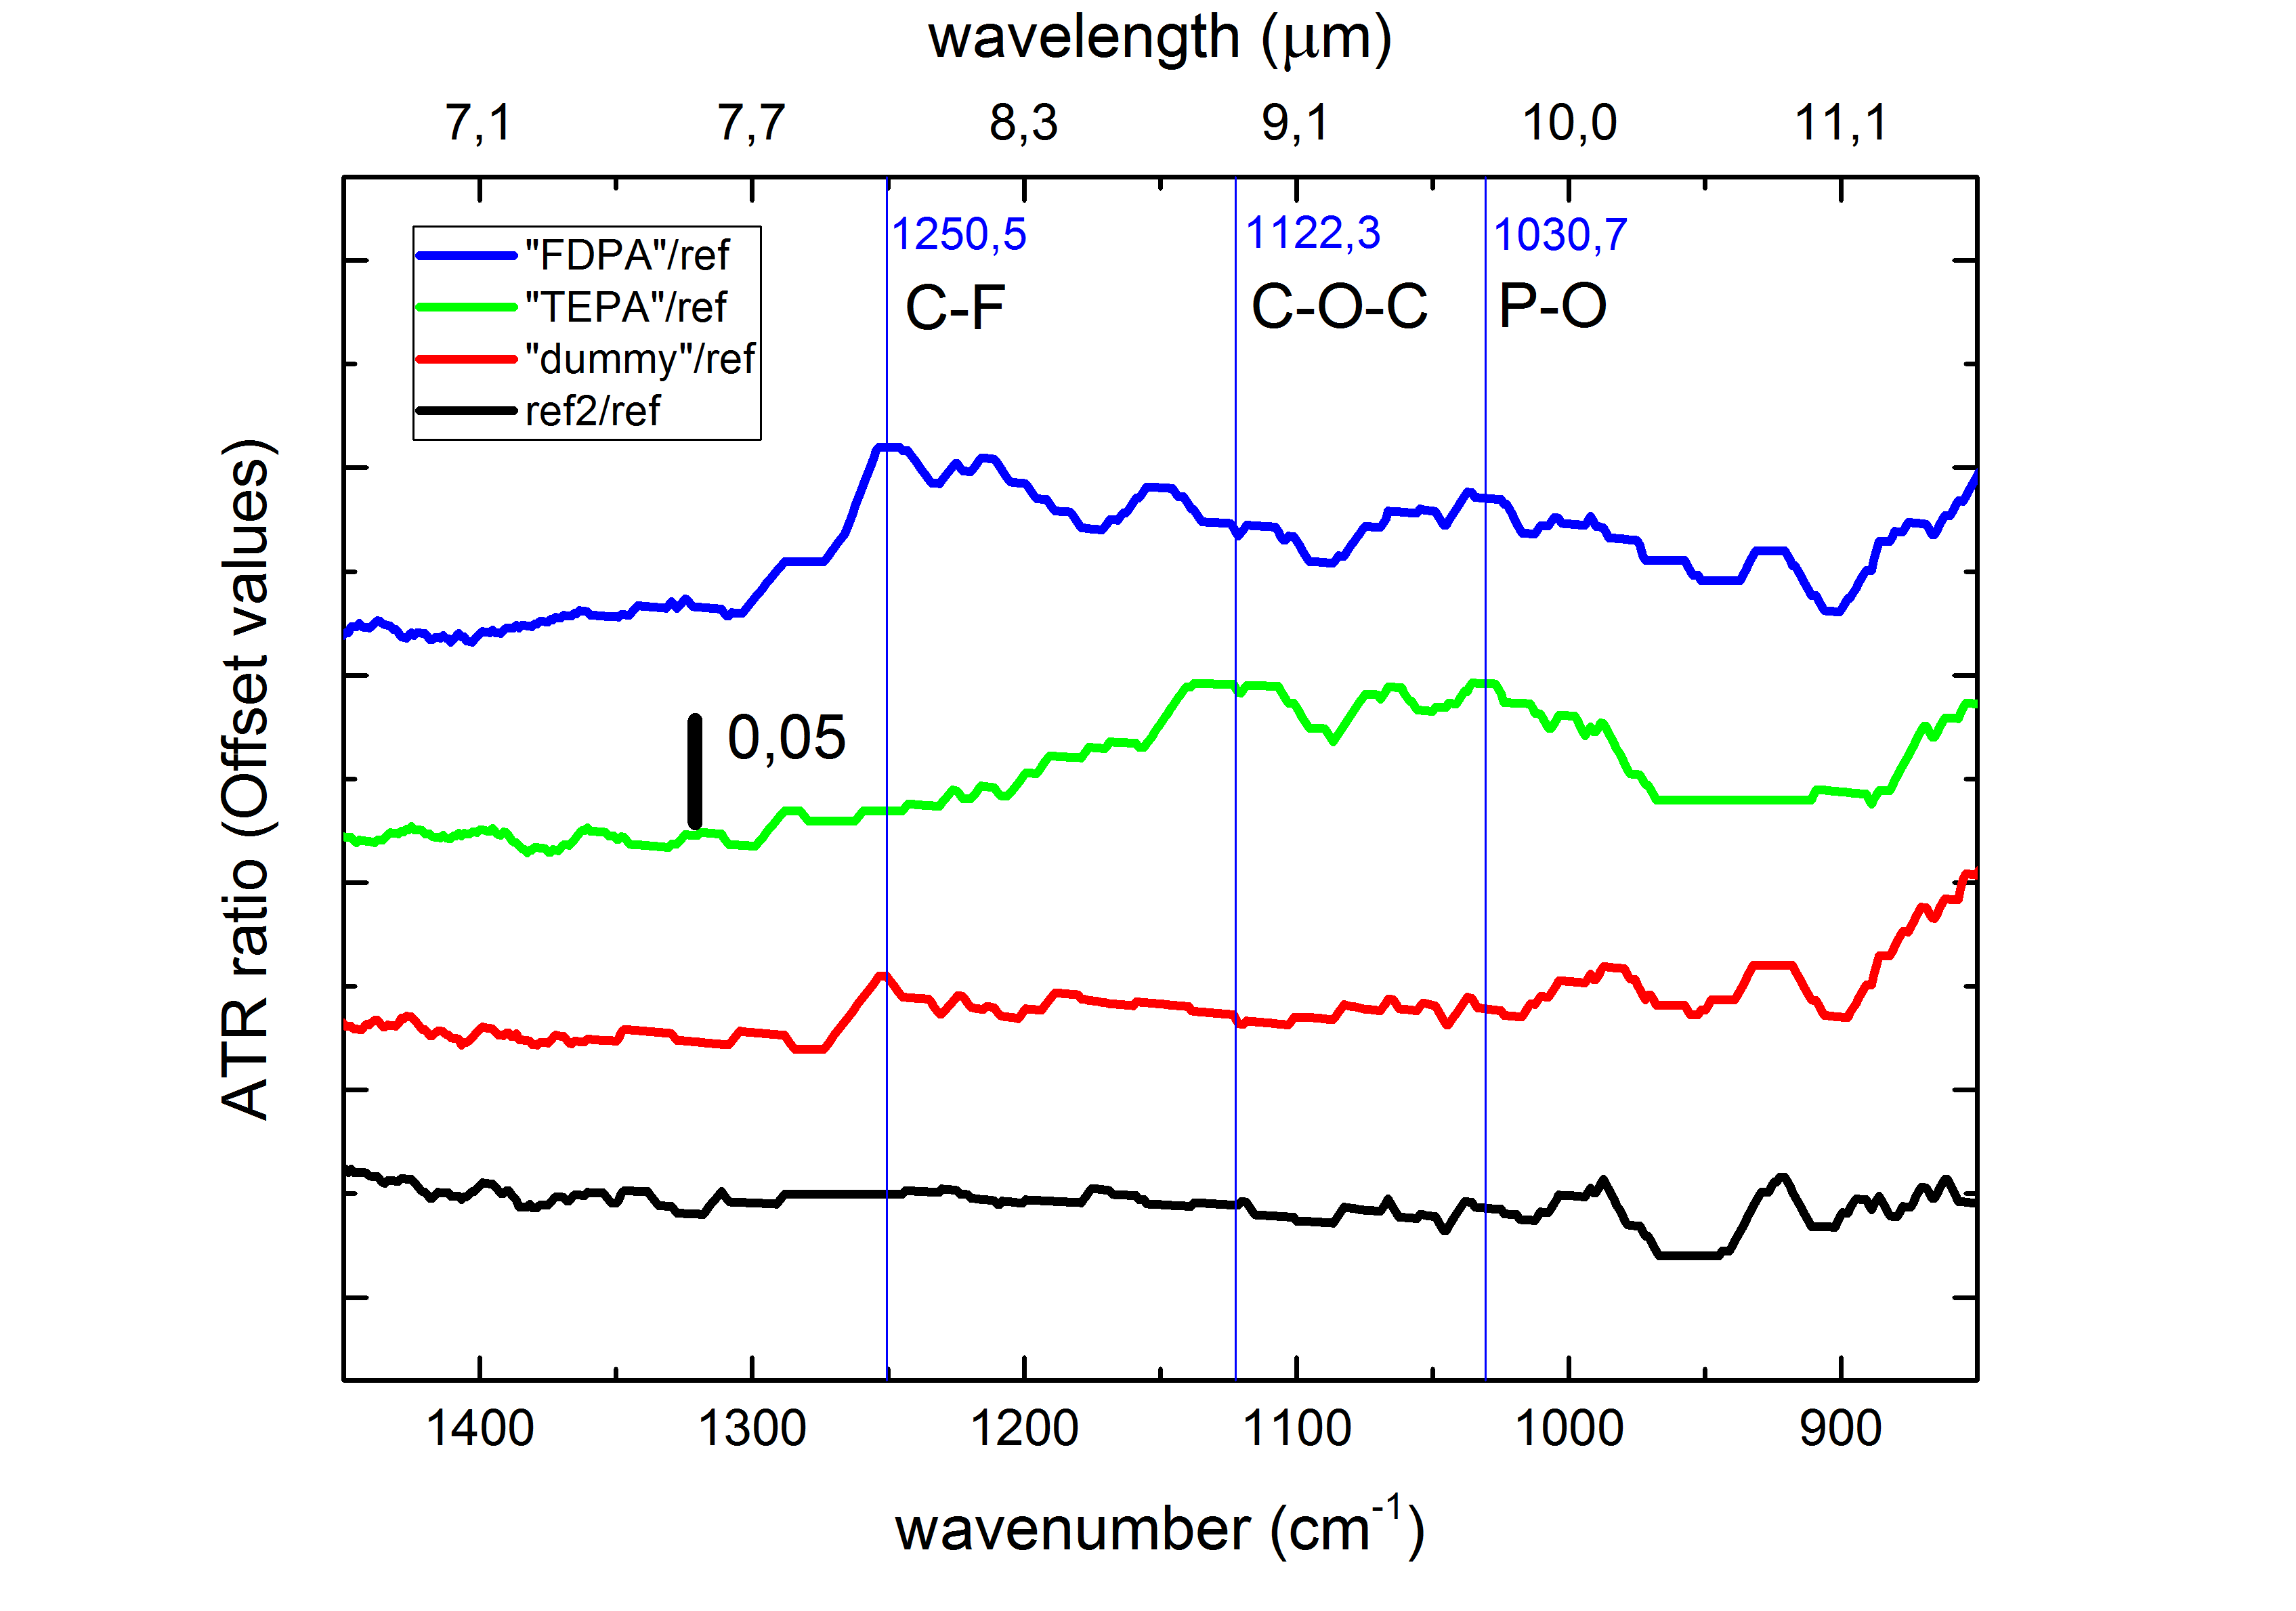
ATR-Spectroscopy
Plasma treatment
+ ultrasonic solvent cleaning
Untreated reference sample
5

Slide 6
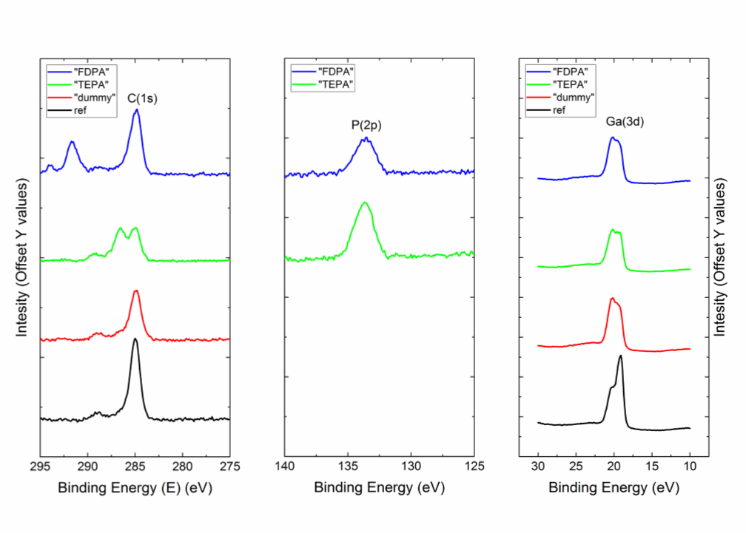
XPS-measurements
Plasma treatment
+ ultrasonic solvent cleaning
Untreated reference sample
6

Slide 7
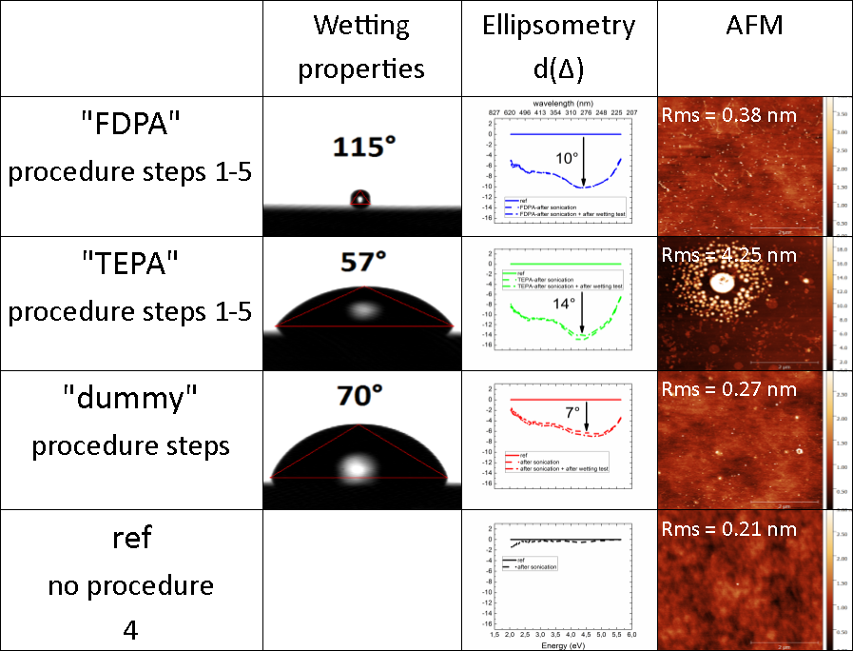
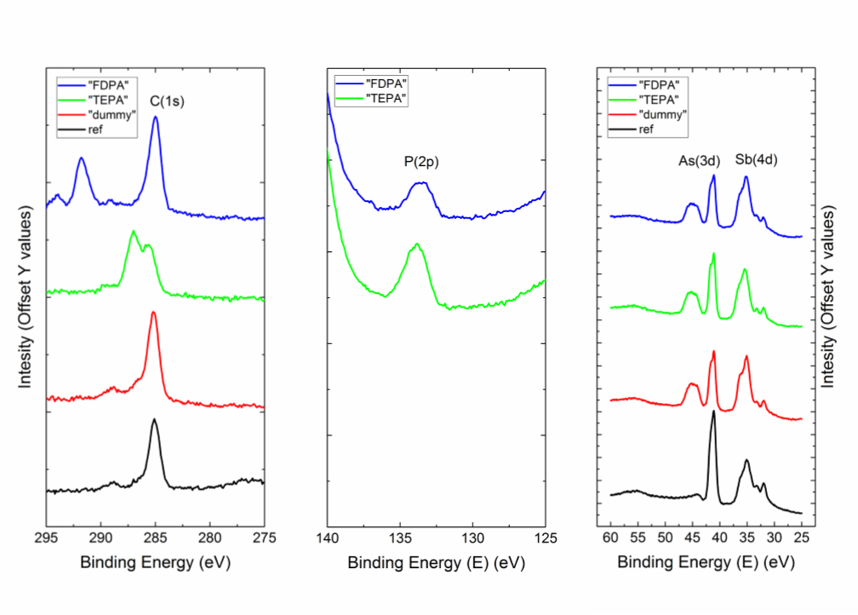
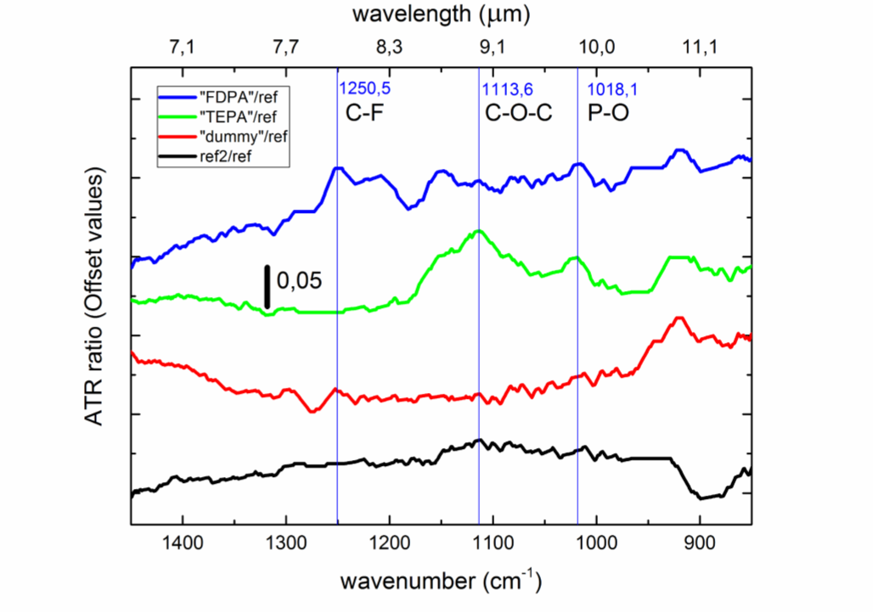
InAsSb:Si surface
Plasma treatment
+ ultrasonic solvent cleaning
Untreated reference sample
ATR
XPS
7

Slide 8
Conclusion
Successful deposition of molecules
Stable upon sonication (6 min)
Potentially multi-layer deposition
Outlook
Additional characterization techniques, e.g.
Thermogravimetric analysis (microbalance)
Fluorescence
Stability test under physiological conditions
Deposition on nanostructures => SEIRA effect
8

Slide 9
Acknowlegements
All the persons who have contributed in the different aspects of this work:
Prof. Dr. Thierry Taliercio
Dr. Aude Mezy (Sikémia)
Dr. Laurent Cerutti
Prof. Dr. Eric Tournié
Dr. Richard Arinero
Dr. Fernando Gonzales-Posada
Dr. Valérie Flaud (XPS)
Dr. Maria José Milla Rodrigo
Dr. Franck Martin (Sikémia)
Franziska Bahro
The agencies which funded this work:
European Commission (PROMIS)
ANR (Supreme-B, EquipEx EXTRA)
University of Montpellier, CNRS and IES

